Slide 1

EXPLORING TAXI FARE PATTERNS: FACTORS INFLUENCING PRICING DYNAMICS
CAPSTONE PROJECT - DATA 69099
Presented by
Harsha Vardhan Amara - 811302928
Naga Sudha Pavani Tirumalasetty – 811294971
Subhasmita Maharana - 811263851

Slide 2

Content
Abstract
Introduction
Research Question
Machine Learning Models Used
Data Pre-processing
Exploratory Data Analysis
Feature Selection & Modeling
Interpretation & Discussion on results
Conclusion

Slide 3

Abstract
Yellow taxis have long been an iconic symbol of New York City's bustling streetscape and are an integral part of the city's transportation network. The yellow taxi services in New York City are thoroughly examined in this essay, with particular attention paid to their historical significance, legal environment, operational dynamics, and present difficulties.
Customer preferences, fleet composition, technology usage, and driver demographics are all part of the operational dynamics of yellow cab services. The introduction of ride-hailing services such as Uber and Lyft has caused a disturbance in the conventional taxi sector, presenting opportunities as well as challenges for fleet owners and yellow taxi drivers.
The outcomes of this analysis aim to enhance understanding of urban mobility and could influence future transportation policy and urban planning decisions, particularly in optimizing taxi operations for better efficiency and customer satisfaction in metropolitan settings.

Slide 4
Introduction
The New York City Taxi and Limousine Commission (TLC) collects comprehensive trip data for yellow taxis operating within the city. This dataset, known as the Yellow Taxi Trip Records, provides detailed insights into the daily operations of these cabs, capturing a variety of variables for each trip including the dates and times of pickup and drop-off, passenger counts, trip distances, pickup and drop-off locations, fare amounts, and types of payment used.
This extensive collection of data not only aids in monitoring and regulating taxi services but also serves as a crucial resource for urban studies. Researchers and policymakers utilize this dataset to analyze patterns in urban mobility, assess the efficiency of the public transport system, and make informed decisions about traffic management, city planning, and transportation policies.
The dataset's rich detail allows for an in-depth examination of how taxi usage varies by time of day and day of the week, providing a window into the rhythm of city life in New York City. By exploring specific research questions such as the variation in taxi activity across different times and areas and the difference in fare amounts between weekdays and weekends, this study seeks to uncover trends that could lead to improved taxi services and enhanced urban planning strategies.

Slide 5

Research Question
EXPLORING TAXI FARE PATTERNS: FACTORS INFLUENCING PRICING DYNAMICS-
How does the combination of pickup location and trip distance influence the fare amount for taxi rides in New York City?
How does the average fare amount for taxi rides differ between weekdays and weekends in New York City?

Slide 6

Structural Outline
Data Preprocessing & Cleaning
Exploratory Data Analysis
Descriptive statistics
Visualization to understand the data
Data Modelling using Machine Learning models
Prediction & Visualization of data to understand the modelling
Results of modeling

Slide 7
Machine learning techniques used in this analysis
Gradient Boosting Regression
Linear Regression
It is a potent machine learning technique that improves prediction accuracy by combining multiple weak predictors into a strong model, especially effective for complex, non-linear relationships within data like the Yellow Taxi Trip Records. It sequentially builds upon each model to correct previous errors, allowing it to handle diverse data types and optimize different loss functions, thereby making it highly effective for predicting variables such as fares and trip durations.
It is a interpretable approach for analyzing relationships in the Yellow Taxi Trip Records dataset, such as the impact of trip distance, passenger count, and time of day on fare amounts. It serves as an effective baseline model for predicting continuous outcomes, ideal for initial exploratory data analysis to derive preliminary insights before employing more complex modeling techniques.

Slide 8
Data Pre-Processing
Import necessary packages & displaying the data in as DataFrame.
The commonly used methods in pandas DataFrame for exploring and understanding the structure and content of a dataset.
df.shape- There are a total of 2463931 rows and 19 columns.
df.columns- returns the column labels of DataFrame.
df.dtypes- returns the datatypes of each column in DataFrame.
df.info- returns the concise summary of the DataFrame, including information about the index, column names, non-null values, and data types of each column, as well as memory usage.

Slide 9
Data Cleaning
Checking for missing values using data_df.isnull().sum() and removing them accordingly from the DataFrame using data_df.dropna(inplace=True)
The number of missing values before removing it 71503 for the variable’s passenger_count, RatecodeID, store_and_fwd_flag, congestion_surcharge, airport_fee.
Checking for unnecessary columns and removing it accordingly. Removed the column tolls_amount which we haven’t used in the Analysis.
Now there 2392428 rows 18 columns after the removal of missing values and unnecessary columns.

Slide 10
Exploratory data analysis- Descriptive statistics
The Descriptive Statistics provides statistical information such as count, mean, standard deviation, minimum, maximum, and various percentiles for numerical columns in the DataFrame.
If the DataFrame contains non-numeric columns (e.g., strings or datetime objects), the describe() method will only provide statistics for the numeric columns, skipping the non-numeric ones.
Descriptive statistics help us understand the distribution and characteristics of the data.

Slide 11

Considering relevant features
Analyzing the data and selecting relevant columns for visualizations.
Converting pickup and drop-off variables from object data type to datetime data type in DataFrame.
And selecting the ‘pickup_hour’ and ‘pickup_dayofweek’ variables accordingly from pickup and drop-off variables.
Creating a new variable named ‘day_category’ for specifying the day as Weekday or Weekend.

Slide 12
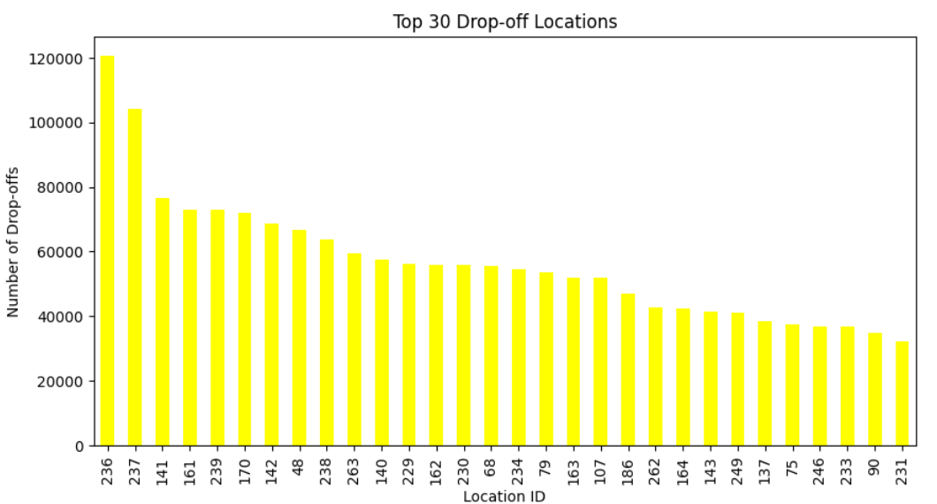
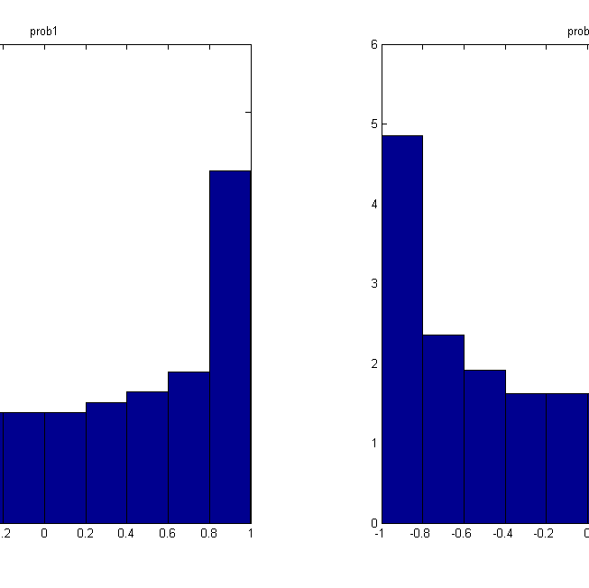
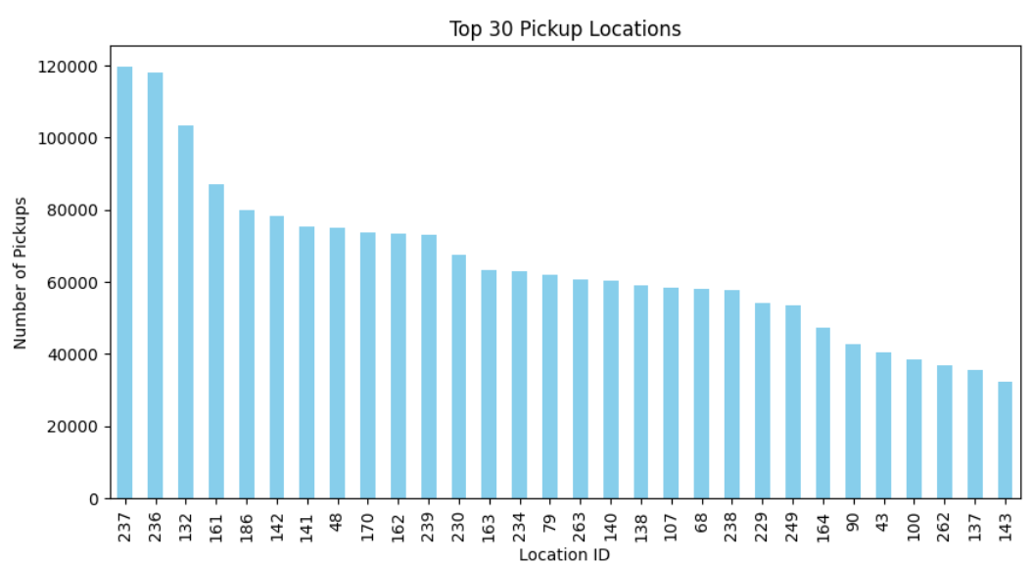
Exploratory data analysis- Visualizations: to understand the data
Displays the top 30 Pick-up locations:
Displays the top 30 Drop-off locations:

Slide 13
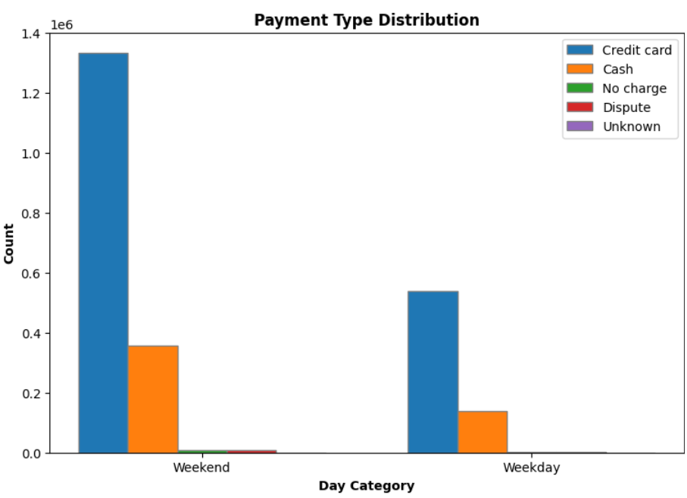
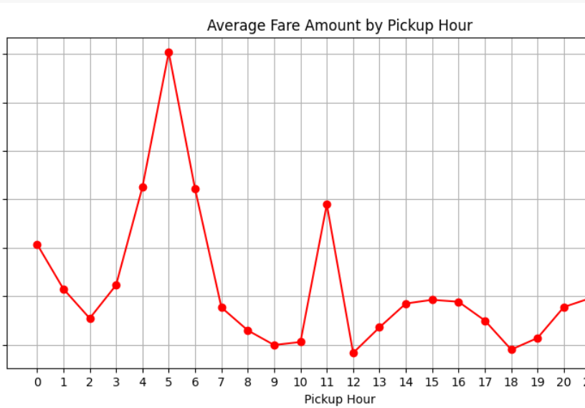
Exploratory data analysis- Visualizations: to understand the data
Distribution of Average fare amount by Pickup Hour
Distribution of Payment Type in the Dataset

Slide 14
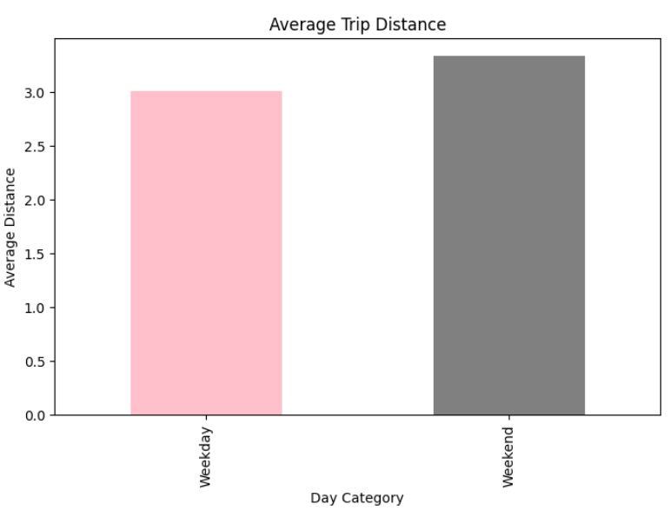
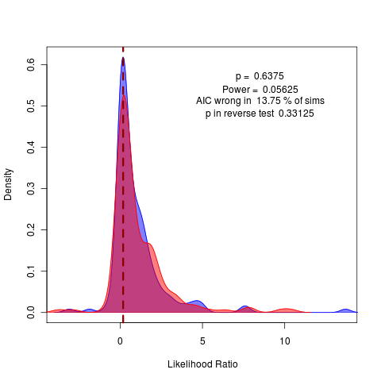
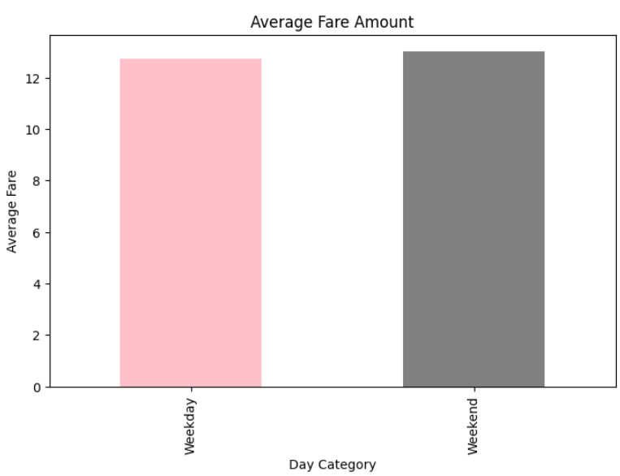
Exploratory data analysis- Visualizations: to understand the data
Distribution on Average Fare amount
Distribution on Average trip distance

Slide 15
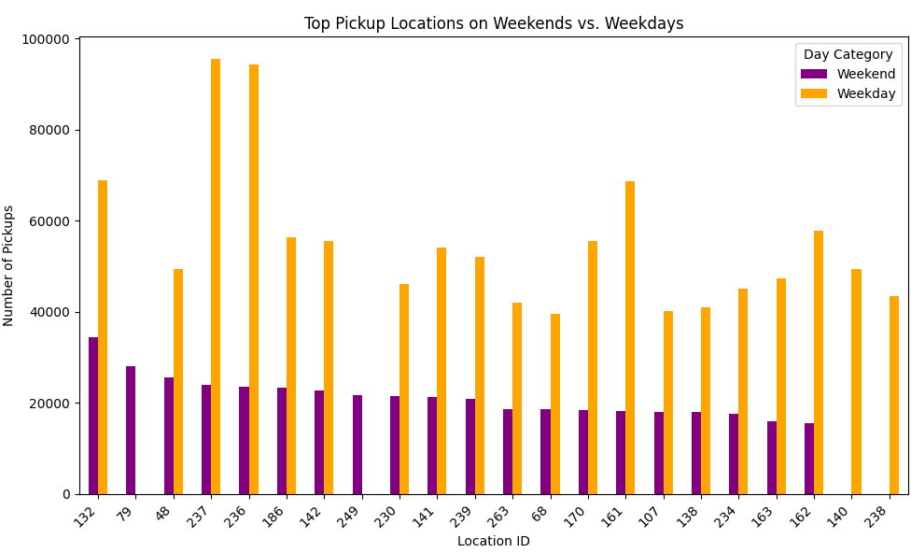
Exploratory data analysis- Visualizations: to understand the data
Distribution of Locations based on Weekdays vs. Weekends

Slide 16
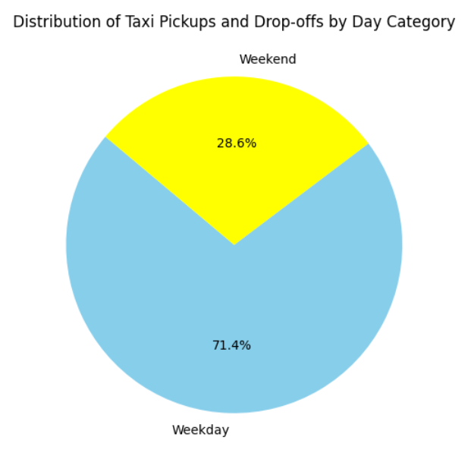
Exploratory data analysis- Visualizations: to understand the data
Distribution of Taxi pickups and drop-offs on Weekdays & Weekends

Slide 17
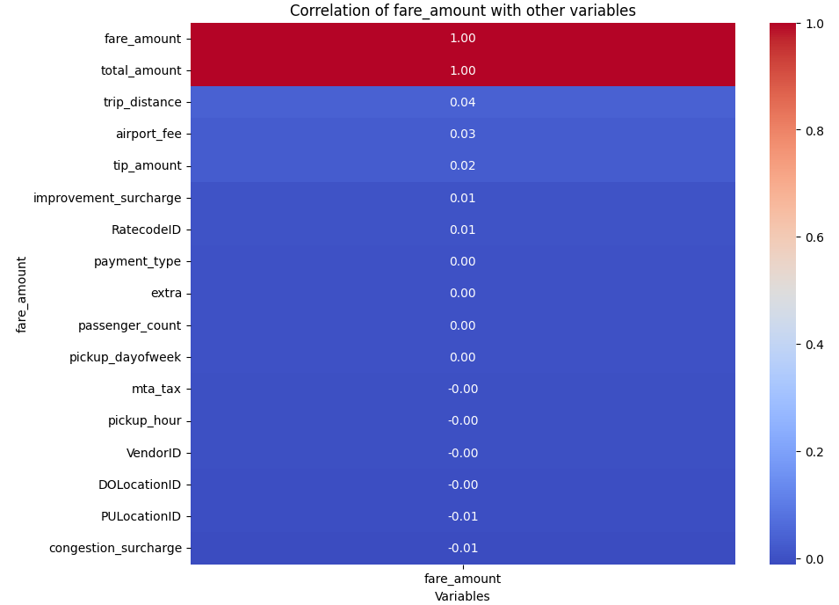
Correlation Map
The correlation analysis reveals insights into factors influencing taxi fare amounts. Notably, fare amount shows minimal correlation with trip distance (0.039), airport fee (0.027), tip amount (0.024), and improvement surcharge (0.007). This suggests that while these factors may have some influence, their impact on fare amount is relatively weak. However, it's essential to consider them collectively when determining fare structures and pricing strategies. Understanding these correlations aids in optimizing fare calculations and providing transparent pricing mechanisms in urban transportation systems.

Slide 18
Machine Learning Modeling implementation- Feature Selection
Implementation1
Implementation2
Gradient Boosting Regression
Gradient Boosting Regression & Linear Regression
Feature Variable: PULocationID, trip_distance
Target Variable: fare_amount
Feature Variables: trip_distance, pickup_dayofweek
Target Variables: fare_amount

Slide 19

Machine Learning Modeling & Metrics implementation-1
Gradient Boosting Regression Interpretation
Our model exhibited promising performance metrics, with a Mean Squared Error (MSE) of 44.36, indicating the average squared difference between the predicted and actual fare amounts. The Root Mean Squared Error (RMSE) of 6.66 signifies the average magnitude of these errors in the original units of fare amounts, reflecting the model's accuracy.
Moreover, the Mean Absolute Error (MAE) of 1.97 suggests that, on average, the model's predictions deviate by approximately $1.97 from the actual fare amounts. Additionally, the R-squared (R²) value of 0.71 indicates that approximately 70.8% of the variance in fare amounts can be explained by the features included in the model.

Slide 20

Machine Learning Modeling & Metrics implementation-2
Gradient Boosting Regression Interpretation
Our model achieved comparable results to the previously reported ones, with a Mean Squared Error (MSE) of 49.12, indicating the average squared difference between the predicted and actual fare amounts. The Root Mean Squared Error (RMSE) of 7 signifies the average magnitude of these errors in the original units of fare amounts, reflecting the model's accuracy.
Moreover, the Mean Absolute Error (MAE) of 1.91 suggests that, on average, the model's predictions deviate by approximately $1.91 from the actual fare amounts. Additionally, the R-squared (R²) value of 0.68 indicates that approximately 67.6% of the variance in fare amounts can be explained by the features included in the model.

Slide 21

Machine Learning Modeling & Metrics implementation-2
Linear Regression Interpretation
Our model achieved comparable results to the previously reported ones, with a Mean Squared Error (MSE) of 48.45, indicating the average squared difference between the predicted and actual fare amounts. The Root Mean Squared Error (RMSE) of 6.96 signifies the average magnitude of these errors in the original units of fare amounts, reflecting the model's accuracy.
Moreover, the Mean Absolute Error (MAE) of 2.27 suggests that, on average, the model's predictions deviate by approximately $2.27 from the actual fare amounts. Additionally, the R-squared (R²) value of 0.68 indicates that approximately 68% of the variance in fare amounts can be explained by the features included in the model.

Slide 22
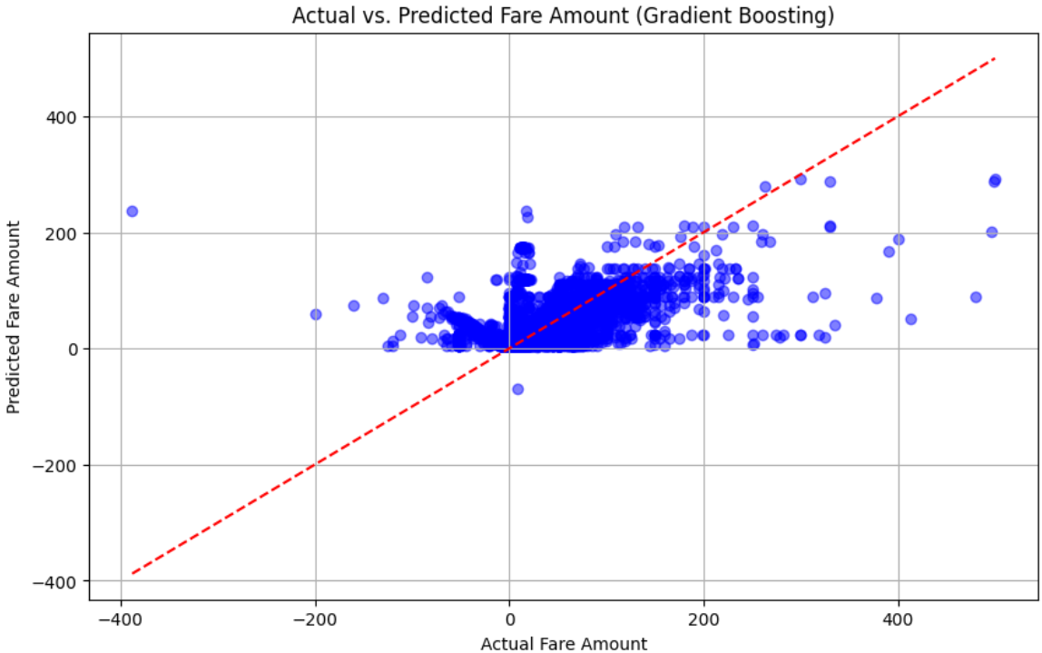
Visualization Results: to understand modeling-1
Residual plot for Predicted Trip Distance

Slide 23
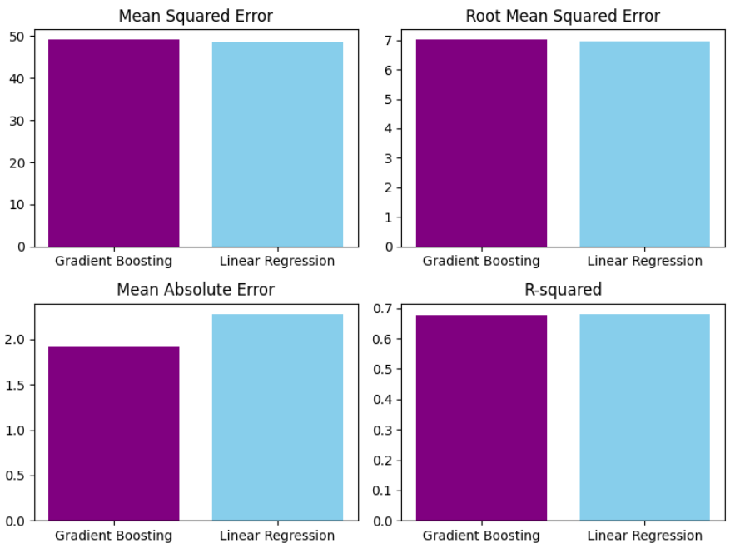
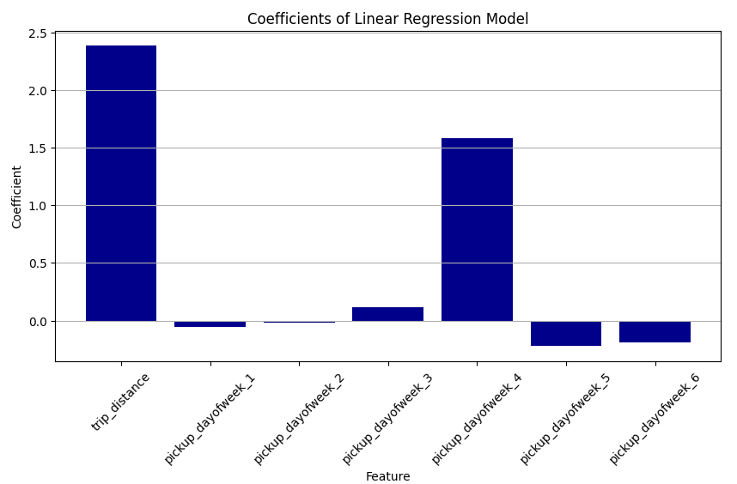
Visualization Results: to understand modeling-2
Coefficients of Linear model based on features
Comparing the metrics for GradientBoosting & LinearRegressor model

Slide 24
Conclusion
The analysis revealed significant insights into taxi fare determination in New York City. Firstly, the combination of pickup location and trip distance notably impacts fare amounts, with longer distances and specific pickup locations correlating with higher fares. This underscores the importance of spatial and distance factors in fare estimation. Secondly, the average fare amount was found to be higher on weekends compared to weekdays in New York City. This unexpected finding challenges conventional assumptions about taxi usage patterns, suggesting that factors such as leisure activities, events, and nightlife may contribute to increased demand and subsequently higher fares on weekends. These findings underscore the nuanced interplay between temporal and spatial factors in taxi fare determination, providing valuable insights for urban transportation planning and fare pricing strategies in New York City.

Slide 25
Future Scope
In future iterations of the "Exploring Taxi Fare Patterns: Factors Influencing Pricing Dynamics" project, potential enhancements could include the development of dynamic pricing models using time-series and geographic forecasting techniques. These models could help enhance revenue generation and operational efficiency. Additionally, incorporating historical data on local events could provide valuable insights into fare dynamics. Moreover, the project could benefit from the creation of user-friendly tools and comprehensive analyses of the economic and regulatory impacts. Introducing consumer apps featuring interactive dashboards and fare calculation tools would foster greater engagement and transparency, while ensuring competitive and equitable market processes. These advancements would contribute to a deeper understanding of taxi fare patterns and improve decision-making in urban transportation systems.

Slide 26

Thank you!
https://colab.research.google.com/drive/1TLEP-Ee8s_H1M5xDNeYDp8R0o7XpZREn#scrollTo=dryX8xT2MKnI

